Slide 1
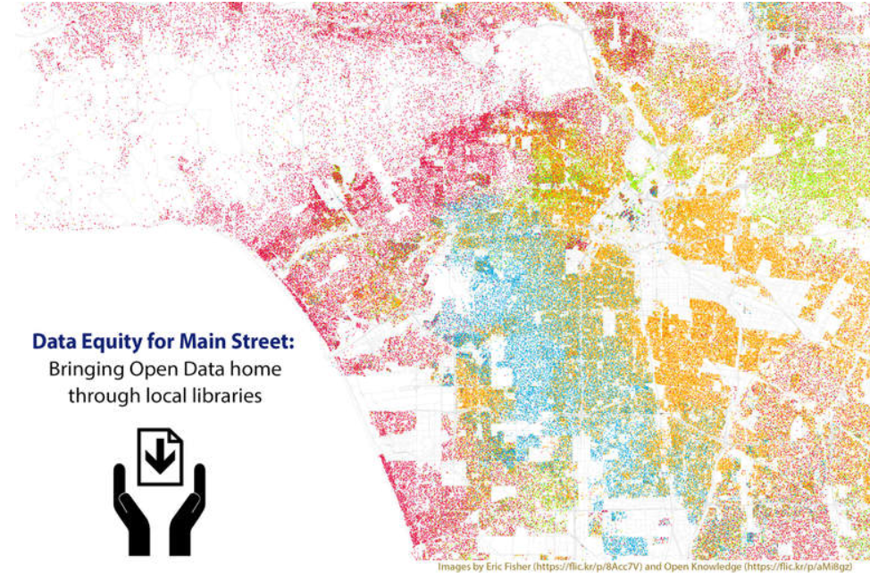
Unlocking the Power of Open Data
Class 4

Slide 2
Review from Sessions 1, 2 & 3
Where are some places I might find open data?
What kind of questions can open data answer?
What are some ways in which you might visually represent your data?
What are some common misrepresentations of data?
How can you use data to tell a story?
What are some common mistakes in representing data visually?
Notes:
Class 4a: Review Class 1-3
Learning Objective: Demonstrate familiarity with topics from Class 1-3
Discussion: By now everyone has learned a lot about open data and is almost ready to take on using open data to answer their own questions.
Ask the class:
Where are some places I might find open data?
What kind of questions can open data answer?
What are some ways in which you might visually represent your data?
What are some common misrepresentations of data?
How can you use data to tell a story?
What are some common mistakes in representing data visually?
Explain that in this section they will have the opportunity to get hands-on experience in answering open data questions and will become an active member of the open data community.

Slide 3
Review from Sessions 1, 2 & 3 (cont’d)
-Data visualization examples since the last class?
Notes:
Activities:
Ask if anyone saw any data visualizations between now and the last class. What did they notice? Show the class one or two visualizations from recent news stories. Ask:
What story are they trying to tell?
What kind of chart or graph are they using?
Are they using that chart correctly?

Slide 4
Objectives
Identify some common mistakes people make when analyzing data and drawing conclusions.
Identify a question and answer it using open data.
Contribute to the open data movement by giving feedback to the publisher(s) on issues such as data quality and ease-of-use.
Notes:
(Same as slide)

Slide 5
Some Common Pitfalls to Avoid:
-Correlation vs Causation
-Average (Mean) vs Median
-Percent vs Percentage Point
Analyzing Your
Data
Notes:
Class 4b: Analyzing Your Data - What does it mean?
Estimated Time: 15 min
Learning Objective: Identify some common mistakes people make when analyzing data and drawing conclusions.
Discussion: It can be tempting to see some data and draw quick conclusions. It’s important to make sure those conclusions are valid. During this segment, we’ll talk about what the data means.

Slide 6
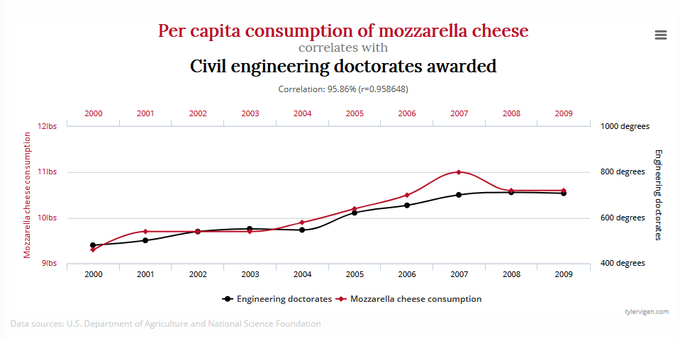
Watch out for spurious correlations! From the data, it looks like these two things are connected, but we can’t come up with any hypothesis for why!
Notes:
Class 4b: Analyzing Your Data - What does it mean?
Activity
Watch out for spurious correlations! Check out Tyler Vigen’s “Spurious Correlations” site http://www.tylervigen.com/spurious-correlations from which this chart comes. From the data, it looks like these mozzarella and civil engineering doctorates are connected, but we can’t come up with any hypothesis for why! If this were a causal relationship, either people eating more mozzarella would cause there to be more civil engineering doctorates awarded, or vice versa!

Slide 7
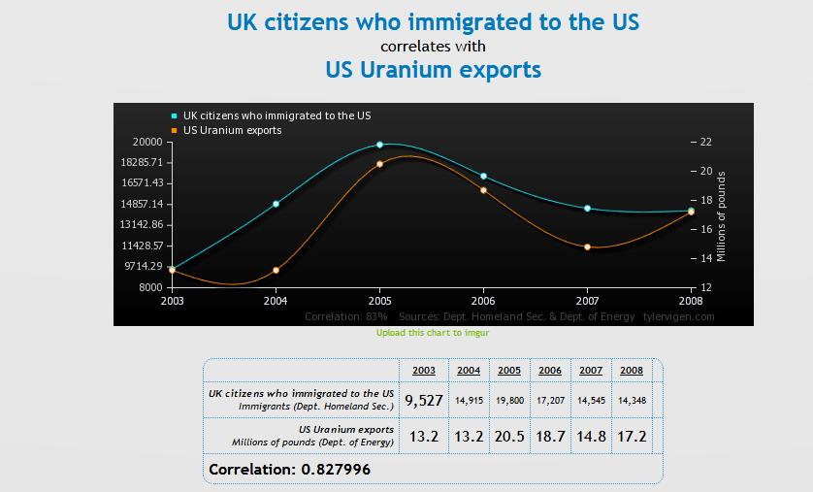
Is the US exporting uranium because the British are coming?
Notes:
Another example: Is the US exporting uranium because the British are coming?
http://tylervigen.com/view_correlation?id=24270
See additional examples: https://www.sjpl.org/blog/sources-unknown-data-literacy

Slide 8
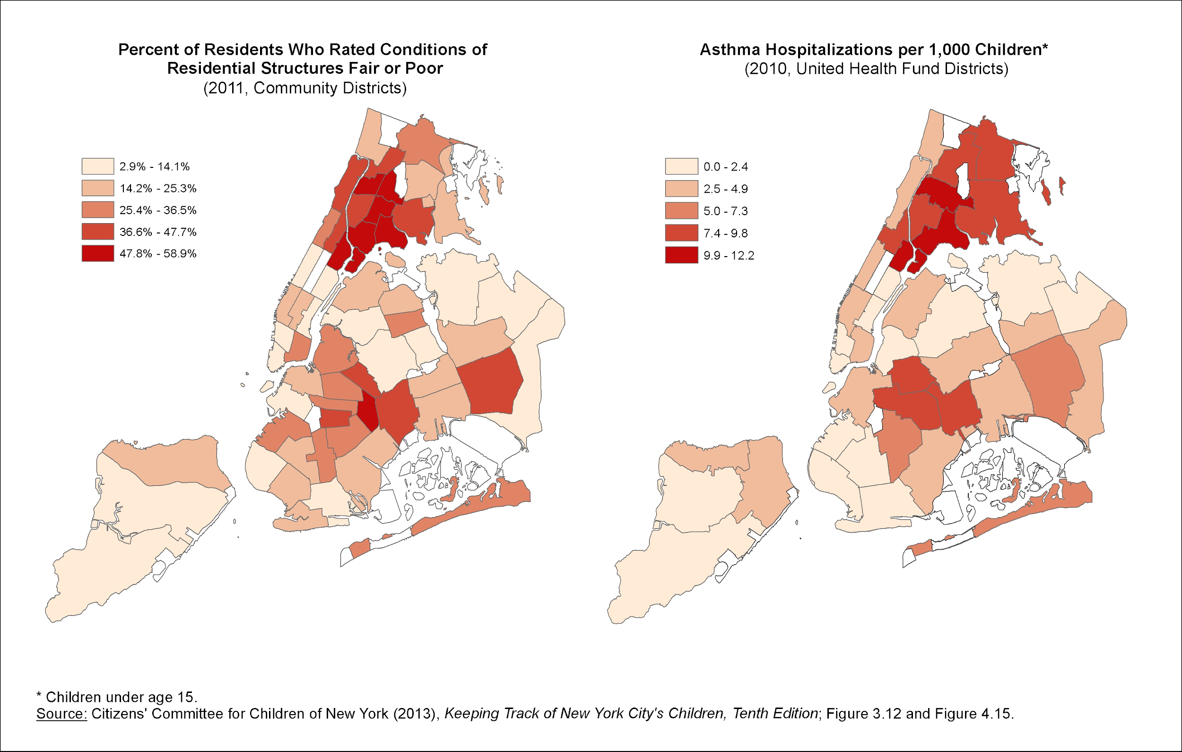
On the other hand, there might be a causal relationship...
Notes:
1) Does the fact that the maps look similar mean that poor housing quality CAUSES kids to be hospitalized with asthma? What would make that true? Is it worth researching? What else could be going on? (Possible answers—something related to income (for example, if lower income means poorer health care and access to meds such as inhalers, it may just be that these kids have more poorly controlled asthma so it rises to the level of hospitalization), something related to housing density rather than quality, something related to geography, etc.) http://www.cccnewyork.org/blog/concentrations-of-risk-asthma-and-poor-housing-conditions/
2) What would you need to know to feel sure it was a causal relationship? (Best answer—the positive result from an interventional study, meaning, starting with two equal groups and exposing one to the potential asthma cause; if there’s a strong difference between the two groups and IF the study was well constructed, we can finally say one thing CAUSES the other…. BUT, sometimes it’s unethical to do this! )
3) For this example, mold has been shown to exacerbate asthma in people who have asthma or are prone to it (it causes the exacerbation, although not necessarily the underlying asthma condition). But, what if there were no evidence for causality? Strong association is also very good evidence! Something can still be important even if it hasn’t been shown to be causal. For example, we know that “mouse, mold, dust mites, dog, cat, cockroach, tobacco smoke, endotoxin and nitrogen dioxide are considered to be important indoor allergens and irritants” and that such irritants exacerbate asthma in the same way as mold, although causation hasn’t been shown for many of them. Get a librarian to help search for literature to show causality, if you don’t want to do it yourself!
4) Where possible, DIVE INTO THE DATA! http://data.cccnewyork.org/

Slide 9
Average (also called Mean)
Grades | Point Equivalent
A | 4.0
A | 4.0
C | 2.0
Sum of grade points | 10.0
Divide 10.0 (sum of grades) by 3 (how many grades you added together)
Grade Point Average: 3.33
Notes:
Class 4b: Analyzing Your Data - #3a Average vs. Median
An average is the sum of a list of numbers divided by the number of items (numbers) in the list.
Here is a simple calculation of the average of grades earned by a student in one semester.

Slide 10
Median
Rental prices per month
700
750
800
850
900
950
1000
1050
2500
Median: 900
It doesn’t matter that one of the numbers is way higher; half of the numbers listed are below 900, and half of them are above
Notes:
Class 4b: Analyzing Your Data - #3a Average vs. Median
The median is the value separating the higher half of a data sample, a population, or a probability distribution, from the lower half. In simple terms, it may be thought of as the "middle" value of a data set, where half of the values fall above the median, and half of the values fall below.
The median is the value separating the higher half of a data sample, a population, or a probability distribution, from the lower half. In simple terms, it may be thought of as the "middle" value of a data set, where half of the values fall above the median, and half of the values fall below.
In this example, it doesn’t matter that one of the numbers is way higher; half of the numbers listed are below 900, and half of them are above

Slide 11
Explore your own open data question
Notes:
Class 4c: Answer your own open data question
Estimated time: 20 minutes
Learning Objective: Identify a question and answer it using open data.
Discussion: Participants were asked at the end of Class 3 to come prepared with their own open data question for Class 4. For those that did not bring a question to class, ask them to work on one or more of the questions one of the Treasure Hunts that they did not already complete.
If the class size is small enough, have the students share their questions with each other (if they feel comfortable). If any students chose the same question, ask if they want to work together.
Some students will be ready to search a government, nonprofit or other open data portal right away, and some might already know exactly where the data is located. Others might need a more directed activity.
Activities:
Have the students write down the answer to these questions (in a group):
What is the question I’m trying to answer? [Example: I’m trying to find out how much crime is in my neighborhood.]
Where might the data I’m looking for be located? Example: crime data from local open data portal or a crime map that used open data. Hint: Have students review Handout 3 for this question.
What is the best way to start searching? Example: search the local open data portal, Google “crime data and [city]”.
Note: If students are interested in exploring demographic information about their neighborhood, http://censusreporter.org is a good resource. In addition, students may want to access Handout 2 again, which focuses on where open data is available.
Regroup the class after 15 minutes and discuss what they were able to find.
Depending on skill level of the class members, some may want more information about assessing data quality. This is available in Handout 5 below.

Slide 12
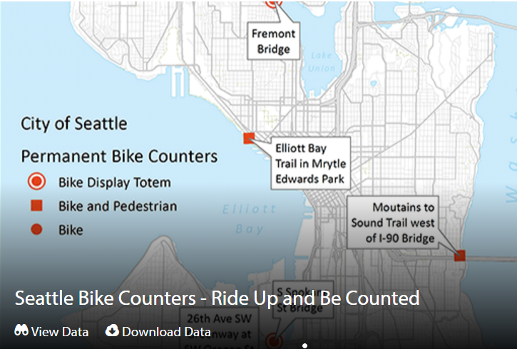
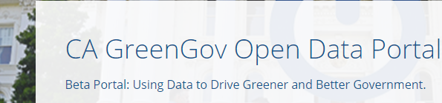
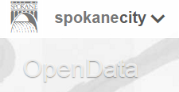
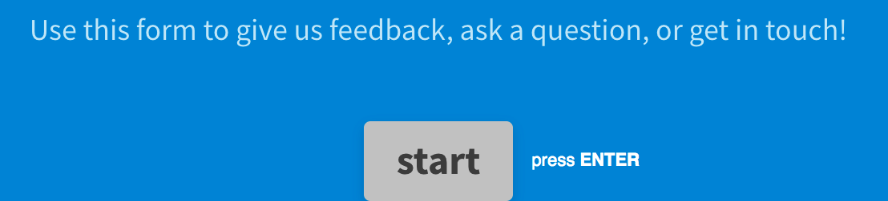

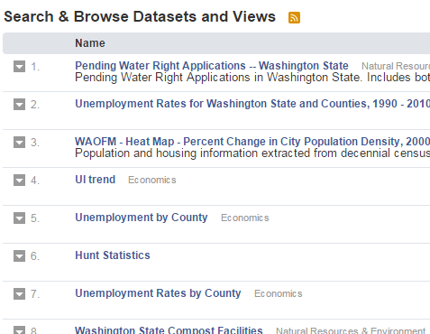



Making Data Better - Giving Feedback
Notes:
Class 4d: Making Data Better- Giving Feedback
Estimated Time: 25 minutes
Learning Objective: Become a contributor to the open data movement by giving feedback to the publisher(s) on quality, ease-of-use etc)
Discussion: This session provides a significant service to government open data programs. In preparation for this module, review anything that did not work well in the previous modules; datasets that did not load, websites that have changed, paywalls and other hassles. Do a quick scan of national news stories about censorship, budget cuts or freedom of information, looking for current event examples that could provide timely context for the lesson.
At the beginning of the session, ask participants:
Have you ever submitted feedback online?
What response did you get? Did it change anything?
Explain that most open data publishers don’t know who’s using their data; that’s part of the anonymity and transparency that publishers commit to when they offer open data. But that anonymity makes it hard for publishers to know or demonstrate the value of their published data, so there’s little incentive for improvement.
Explain that students in this program, working with their local library, can help change that situation and get government to publish more and better open data about the subjects that matter most. Use student responses to the questions in Class 1a (“What Brought You Here”) as examples of subjects that should be prioritized by government.
Activities:
Use a flipchart or whiteboard to capture the top 5 topics that class participants are interested in.
Check your local, state, or federal open data portal to see if the dataset for the topics the class is interested in are available. Explain that if the dataset is not available there are opportunities to suggest it.
Check your local open data portal for a suggestion box.
data.wa.gov
data.seattle.gov
datasf.org
data.gov
Are the data topics represented in the portal you explored? If they all are, brainstorm some possible areas which are lacking and begin to draft a joint email from the class to the open data coordinator.
Start with the positive. Explain in the message that patrons of your host library are interested in using open data for civic purposes and appreciate the open data available
Characterize the message as “suggestions” rather than “requests” (“requests” will probably be interpreted as “demands” and referred to the legal department).
Explain what is good, bad, or missing from a specific dataset identified by the class.
Here’s a sample message text (alter the text to match your interests):
Dear Open Data Publisher,
I’m writing to you on behalf of a group of patrons at the Smallville Public Library in Giant county, Washifornia. We have been using some of your published datasets for civic purposes like [insert your own language: improving traffic safety, understanding our schools, or keeping our residents healthy.] Thank you for publishing this important resource. We have a few suggestions (listed below) for expanding or improving your open data offerings:
In your published dataset on sugary dessert consumption (here’s the link), we noticed that the last update was more than 5 years ago. This is a really useful dataset for us and we’d like to see it prioritized for update.
We couldn’t find any data on your site concerning soda pop spills on public lands. Could you update your index or email us back with tips on how to find it?
Alternate Activities:
Post a story.
A few organizations collect and publish stories about how open data gets used around the world. As a community library your students’ and patrons’ use of open data matters.
Demonstrate the Open Data Impact Map to the class
Use student work product from classes 3c (answer your own question) or 2d (data visualization) as the basis for a group-driven impact story submitted either through this web form or by email, Map@ODEnterprise.org.

Slide 13
Course conclusion
Notes:
Class 4 Evaluation Method and Course Wrap-Up
Review objectives from the sessions
Gather evaluative feedback

Slide 14
Thank
You

